Slide 1
Lending Club Case Study
Suresh Kumar Yatirajula
Sundar Shankar
Srinivasa Marappa
Prateek Pande

Slide 2
Data Understanding

Slide 3
Some Interesting Observations from Data
“Loan Term” is either 36 months or 60 months
Minimum interest is 5.42% and max interest rate is 24.59%
Income of borrowers range from 4K to 6 million, with a mean salary around 68K
Loan Delinquent Borrowers Percentage - ~ 14%

Slide 4
Some Interesting Observations from data
The most common reason for taking loan is: “Debt Consolidation”
Charged Off Loans in Dollars is around ~15%
The loans are categorized from A to Z and then further sub-graded from 1 to 5

Slide 5
Data Understanding
The input loan data file has 39,718 records and 111 columns
Columns with all NULL values:
There are around 54 columns where all values are NULL/NaN
Columns with Majority NULL values:
Out of remaining 57 columns, there are 3 columns, where more than 90% values are NULL
'mths_since_last_delinq','mths_since_last_record','next_pymnt_d'
Columns with only 1 Distinct Value:
There are 6 columns where there is only a one distinct value
'mths_since_last_major_derog', 'annual_inc_joint', 'dti_joint', 'verification_status_joint', 'tot_coll_amt', 'tot_cur_bal',
'open_acc_6m', 'open_il_6m', 'open_il_12m', 'open_il_24m', 'mths_since_rcnt_il', 'total_bal_il', 'il_util', 'open_rv_12m',
'open_rv_24m', 'max_bal_bc', 'all_util', 'total_rev_hi_lim', 'inq_fi', 'total_cu_tl', 'inq_last_12m', 'acc_open_past_24mths',
'avg_cur_bal', 'bc_open_to_buy', 'bc_util', 'mo_sin_old_il_acct', 'mo_sin_old_rev_tl_op','mo_sin_rcnt_rev_tl_op', 'mo_sin_rcnt_tl',
'mort_acc', 'mths_since_recent_bc', 'mths_since_recent_bc_dlq', 'mths_since_recent_inq', 'mths_since_recent_revol_delinq',
'num_accts_ever_120_pd', 'num_actv_bc_tl', 'num_actv_rev_tl', 'num_bc_sats', 'num_bc_tl', 'num_il_tl', 'num_op_rev_tl',
'num_rev_accts', 'num_rev_tl_bal_gt_0', 'num_sats', 'num_tl_120dpd_2m', 'num_tl_30dpd', 'num_tl_90g_dpd_24m', 'num_tl_op_past_12m',
'pct_tl_nvr_dlq', 'percent_bc_gt_75', 'tot_hi_cred_lim', 'total_bal_ex_mort', 'total_bc_limit', 'total_il_high_credit_limit'
['pymnt_plan', 'initial_list_status', 'policy_code', 'application_type', 'acc_now_delinq', 'delinq_amnt']

Slide 6
Data Understanding
Columns with NULL values in more than 90% values
Few columns have more than 90% of data as NULL. These columns are not very useful in the analysis
Columns with either 0 or NaN values:
Some columns have only either 0 or NaN as values. These columns are not very useful in the analysis.
Columns with Missing Values:
There are few columns with missing values. These columns needs to be filled for further analysis
Categorical data which can be converted to Numerical Data:
There are some categorical columns like “Interest Rate percentage”, “loan term”, “employment length” etc… which can be converted to numerical fields for better analysis.
Index(['pymnt_plan', 'initial_list_status', 'policy_code', 'application_type', 'acc_now_delinq', 'delinq_amnt']
'chargeoff_within_12_mths', 'pub_rec_bankruptcies', 'tax_liens'

Slide 7
Data Cleaning and Manipulation

Slide 8
Data Cleaning and Manipulation
The following cleaning/Manipulation steps are done on the input data:
The Columns following properties are dropped :
All values as Null or Empty
only 1 Distinct Value
Values either NaN or 0
Less than 10% of valid values
The following columns that have redundant or unwanted data are dropped:
URL: The information available in url are already part of other columns and hence redundant
loan_amt: Similar information is available in column “funded_amt” and doesn’t seem to add any value
funded_amt_inv, out_prncp_inv , total_pymnt_inv : These columns are strongly correlated to “funded_amt” and doesn’t seem to add any value
The following categorical columns are converted to Numerical columns for better analysis
Term: remove the string “months” from “36 months” & “60 months”. So, the values of the column now become numerical 36 & 60.
int_rate: Remove the symbol “%” from the values.
revol_util: Remove the symbol “%” from the values.
emp_length: Remove the string “Years” and special characters like “<” & “+”.

Slide 9
Data Cleaning and Manipulation
Format and Convert Data Type of Date Fields:
The columns issue_d, last_pymnt_d, last_credit_pull_d & earliest_cr_line are formatted and converted to Date data type
Fill missing values:
last_credit_pull_d: whenever values of this date field are missing, then the values from issue_d are taken
pub_rec_bankruptcies: Missing values of this field are filled with 0
emp_title: This is a string data type column and hence missing values are filled with “NA”
Remove Outliers:
Outlier are identified and removed for the following numerical columns:
funded_amnt
int_rate
Installment
int_rate
annual_inc
delinq_2yrs
inq_last_6mths
open_acc
pub_rec
revol_bal

Slide 10
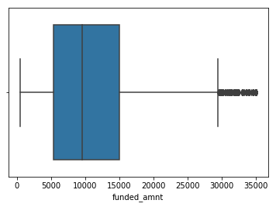
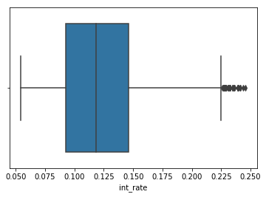
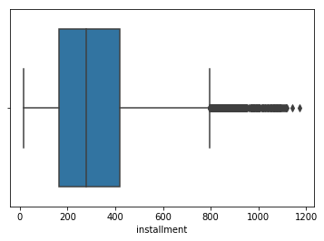
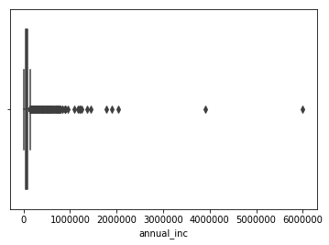
Data Cleaning and Manipulation
Example Outliers Box Plots for “funded_amt”,”int_rate”,”installment”,”annual_inc”:

Slide 11
Data Analysis

Slide 12
Data Analysis
After cleaning and manipulating data, the number of columns have comedown from 111 to 37. The data analysis is done on this cleaned data and some important steps and results are presented below.
Finding Numerical and Categorical Features:
There are 23 numerical and 14 categorical features in the data:
This data helps in understanding the type of variables and possible analysis like uni-variant/bi-variant analysis on them. This data also helps in determining the columns for correlation analysis.
Analysis: Further analysis is done on various column combinations to find and arrive at the correlation between different variables and results are presented in following slides:
Numerical Fields:
Index(['funded_amnt', 'term', 'int_rate', 'installment', 'emp_length', 'annual_inc', 'dti', 'delinq_2yrs', 'inq_last_6mths', 'open_acc', 'pub_rec', 'revol_bal', 'revol_util', 'total_acc', 'out_prncp', 'total_pymnt', 'total_rec_prncp', 'total_rec_int', 'total_rec_late_fee', 'recoveries', 'collection_recovery_fee', 'last_pymnt_amnt', 'pub_rec_bankruptcies'], dtype='object')
Categorical Fields:
Index(['id', 'grade', 'sub_grade', 'emp_title', 'home_ownership', 'verification_status', 'issue_d', 'loan_status', 'purpose', 'title', 'addr_state', 'earliest_cr_line', 'last_pymnt_d', 'last_credit_pull_d'], dtype='object')

Slide 13
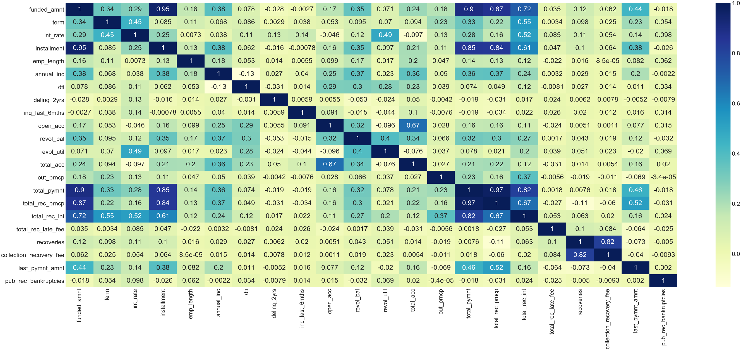
Data Analysis
Correlation plot for numerical data

Slide 14
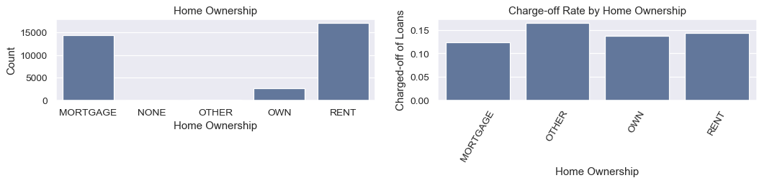
Data Analysis
Uni-Variant and Bi-Variant analysis is done on different columns to analyze the data and their relationship
Some important plots of various columns in relationship with loan default/charge-off
Plot: Charge-off rate by Home Ownership
Plot: Charge-off rate by Home Ownership

Slide 15
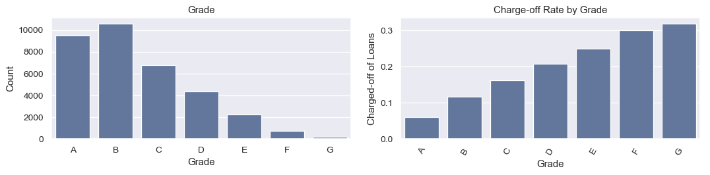
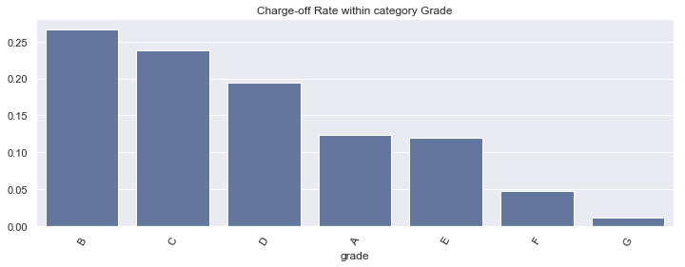
Data Analysis
Plot: Charge-off rate by “Loan Grade”

Slide 16
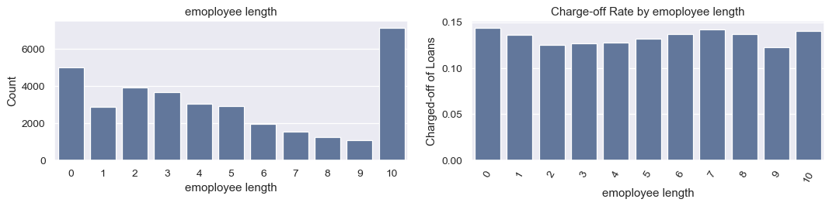
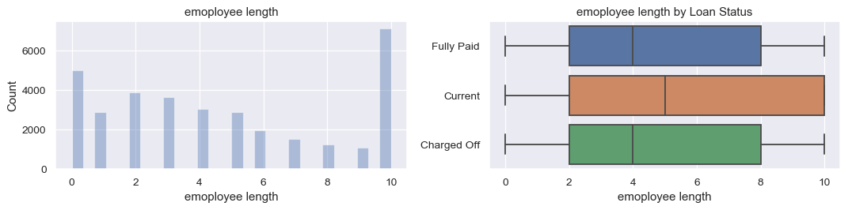
Data Analysis
Plot: Charge-off rate by “Employment Length”

Slide 17
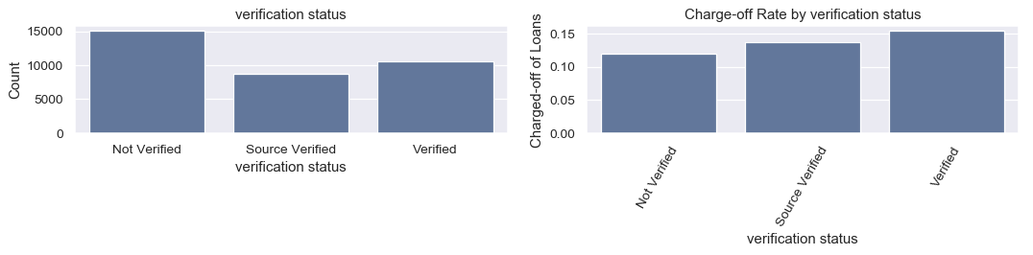
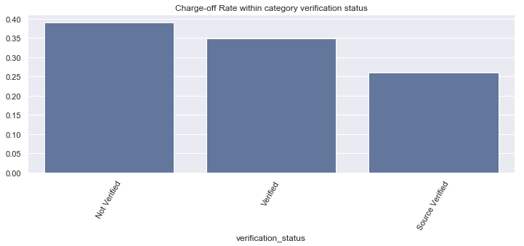
Data Analysis
Plot: Charge-off rate by “Verification Status”

Slide 18
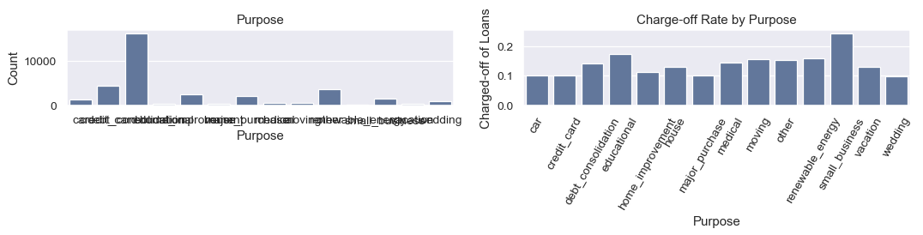
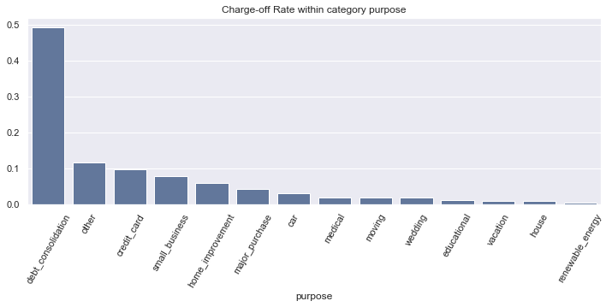
Data Analysis
Plot: Charge-off rate by “Purpose of Loan”

Slide 19
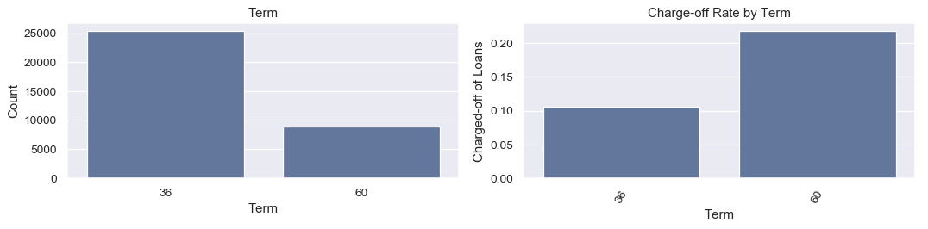
Data Analysis
Plot: Charge-off rate by “Loan Term”

Slide 20
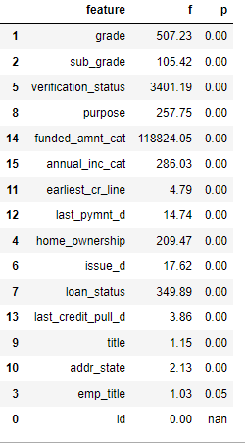
Data Analysis
Annova Analysis on Loan

Slide 21
Results & Recommendations

Slide 22
Results & Recommendations
Based on the above analysis:
Top 5 driving factors behind loan default risk are:
Loan Provider Related Factors:
Loan Tenure of 60 months, will likely to result in more defaults compared to 30 months tenure.
More defaults happen in “small business” and loan is taken for “debt consolidation” purpose.
Loan Consumer Related Factors:
More defaults are happening in less than $20,000 of loan amount
Borrower with 0 years of experience (or) more than 10 years of experience enhances chances of default
Loan Consumer Behavior Related Factors:
Having “Public Rec Bankruptcies” greater than 0 will likely increase the risk of default

